Slide 1
ECDSA
Geoff Huston
APNIC

Slide 2
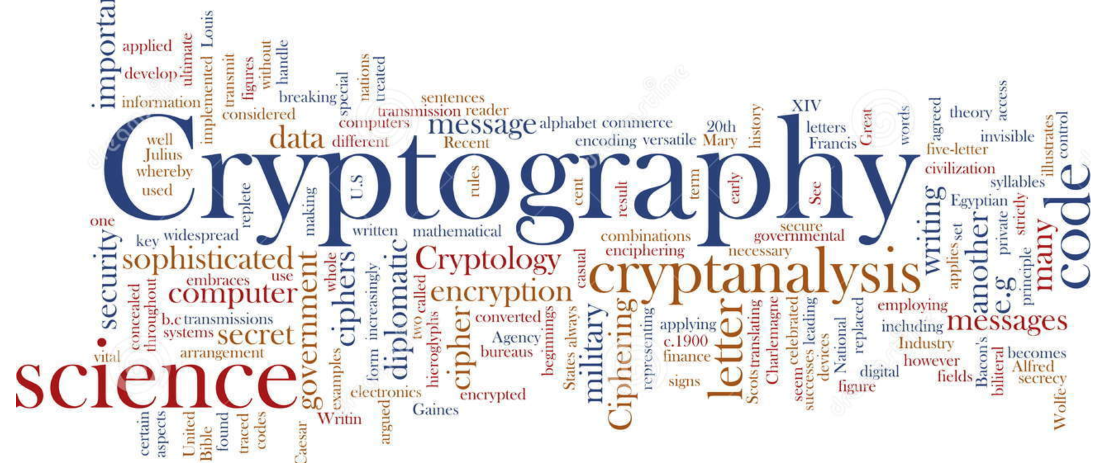
Its all about cryptography

Slide 3
The Basic Challenge
Pick a pair of keys such that:
  Messages encoded with one key can only be decoded with the other key
  Knowledge of the value of one key does not infer the value of the other key

Slide 4
The Power of Primes
(m^{e})^{d} ≡ m (mod n)
As long as d and n are relatively large, and n is the product of two large prime numbers, then finding the value of d when you already know the values of e and n is computationally expensive

Slide 5
The Power of Primes
(m^{e})^{d} ≡ m (mod n)
As long as d and n are relatively large, and n is the product of two large prime numbers, then finding the value of d when you already know the values of e and n is computationally expensive
But computers get larger and faster - what was infeasible yesterday may be possible tomorrow

Slide 6
The Power of Primes
(m^{e})^{d} ≡ m (mod n)
As long as d and n are relatively large, and n is the
product of two large prime numbers, then finding the value of d when you already know the values of e and n is computationally expensive
But computers get larger and faster - what was infeasible yesterday may be possible tomorrow
The way to stay ahead is to make the value of n larger and larger

Slide 7
Why is this important?
Because much of the foundation of Internet Security rests upon this relationship

Slide 8
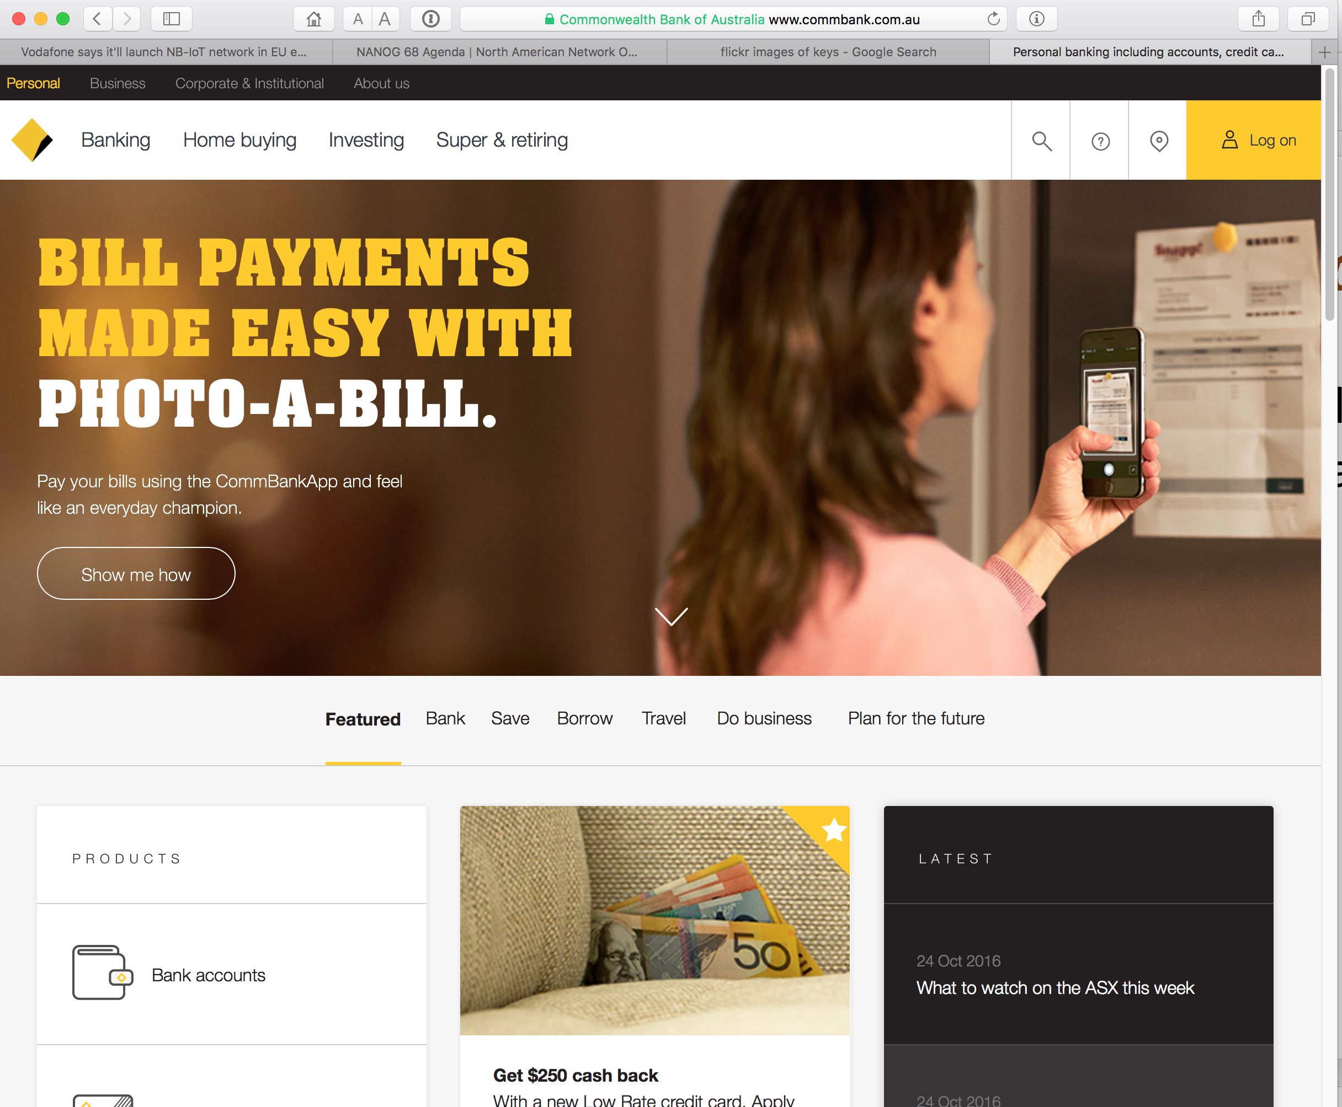
My Bank…(I hope!)

Slide 9
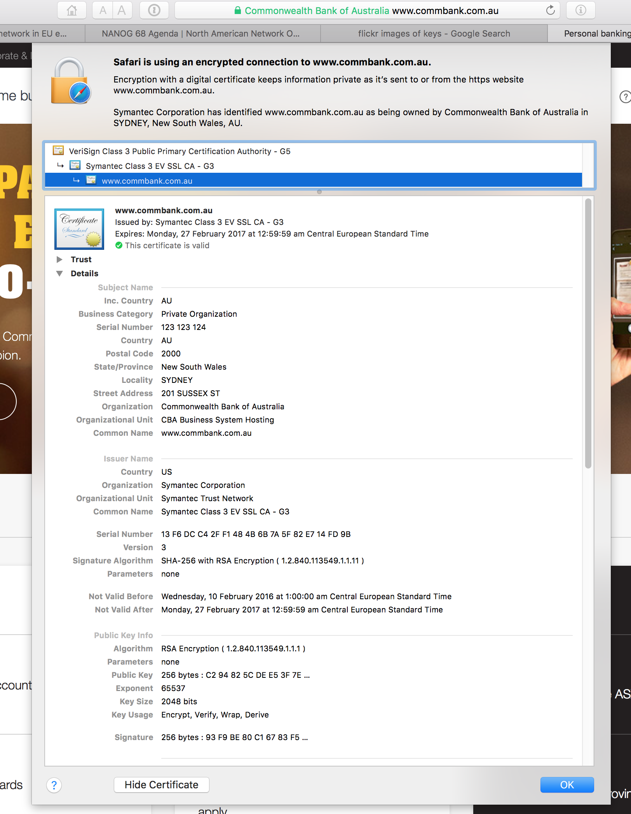
My Bank’s Digital Signature
Yes, that says RSA using a 2048-bit
Public key

Slide 10
Domain Name Certification
The Commonwealth Bank of Australia has generated a key pair
And they passed a certificate signing request to a company called “Symantec”
Who is willing to vouch (in a certificate) that the entity who goes by the domain name of www.commbank.com.au also has a certain public key value
So if I can associate this public key with a connection then I have a high degree of confidence that I’ve connected to www.commbank.com.au, as long as I am prepared to trust Symantec and the certificates that they issue
Why should I trust them?

Slide 11
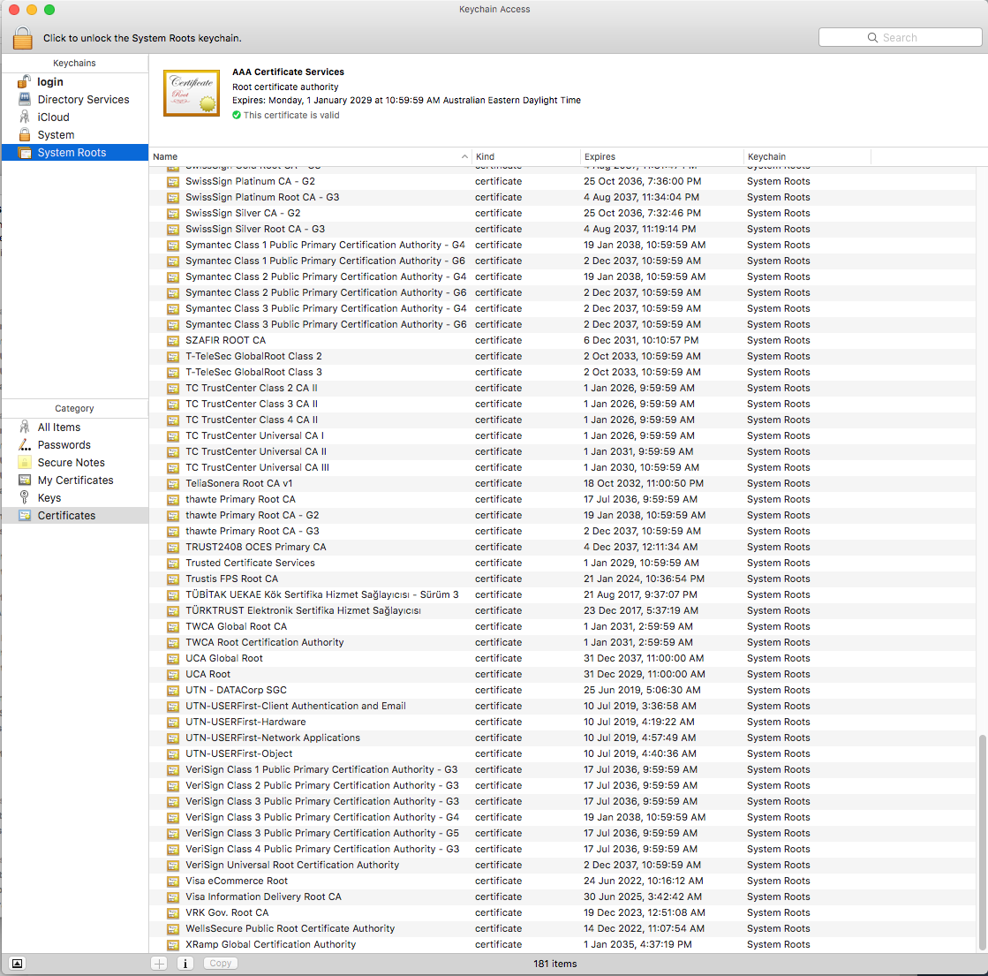
Local Trust
The cert I’m being asked to trust was issued by a certification authority that my browser already trusts – so I trust that cert!

Slide 12
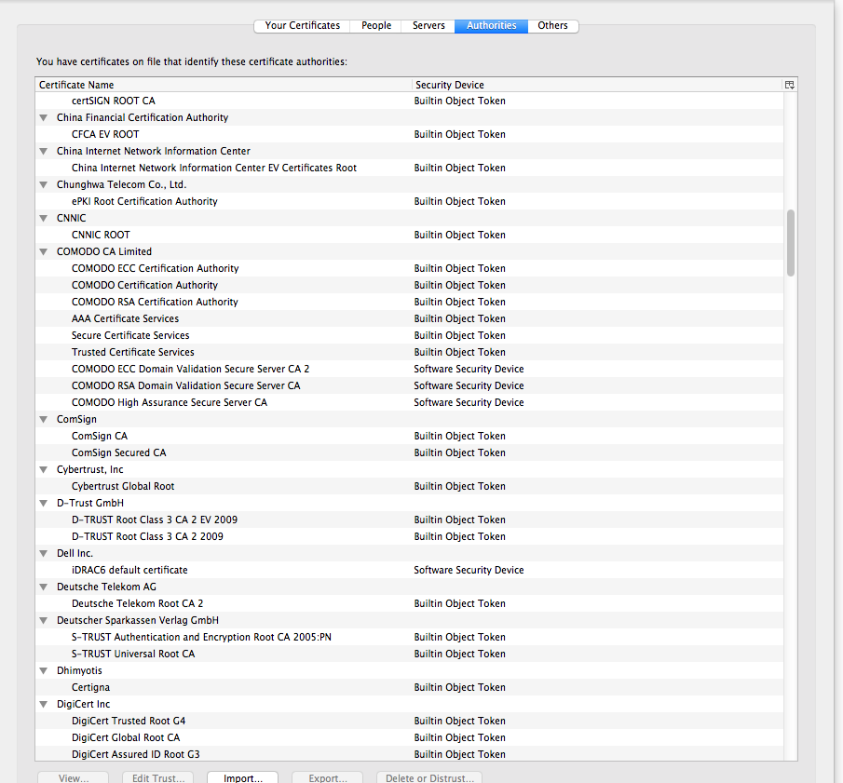
Local Trust
That’s a big list of people to
Trust
Are they all trustable?

Slide 13
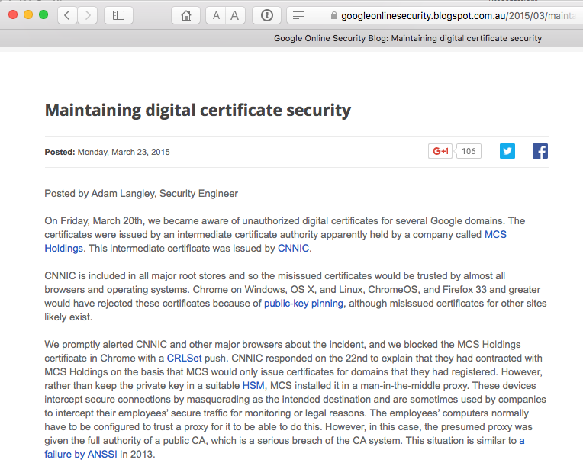
Local Trust
That’s a big list of people to
Trust
Are they all trustable?
Evidently Not!

Slide 14
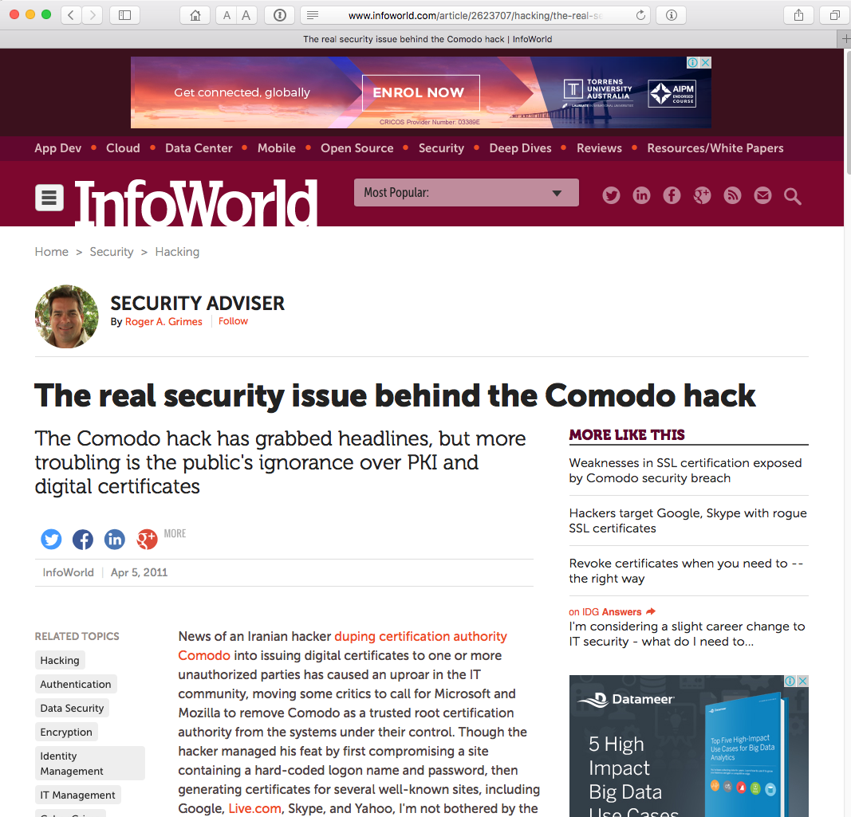
Local Trust
That’s a big list of people to
Trust
Are they all trustable?
Evidently Not!

Slide 15
With unpleasant consequences when it all goes wrong

Slide 16
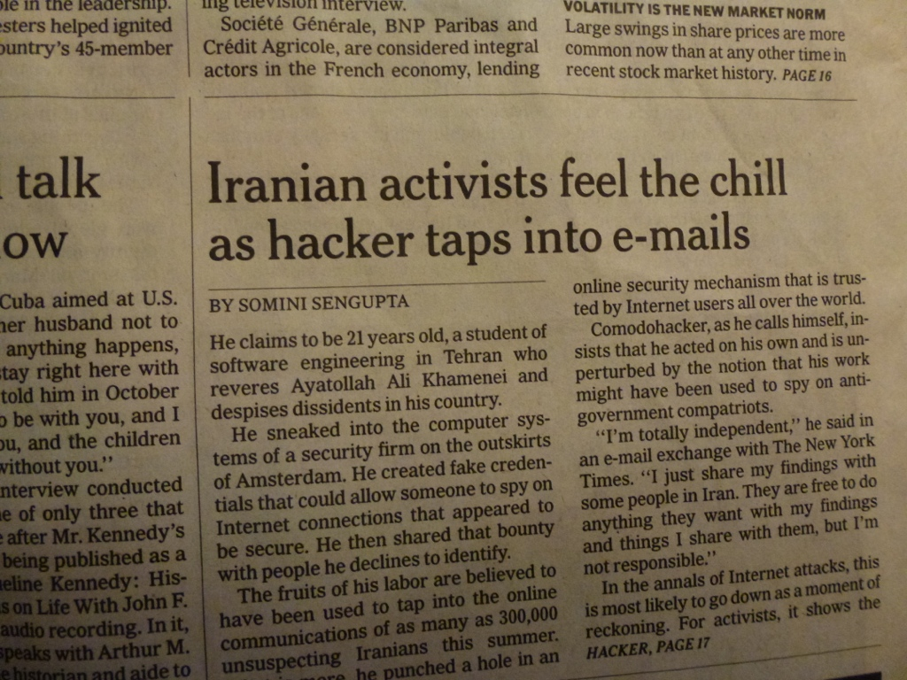
With unpleasant consequences when it all goes wrong
International Herald Tribune
Sep 13, 2011 Front Page

Slide 17
What’s going wrong here?
The TLS handshake cannot specify WHICH CA should be used to validate the digital certificate
Your browser will allow ANY CA to be used to validate a certificate

Slide 18
What’s going wrong here?
The TLS handshake cannot specify WHICH CA should be used to validate the digital certificate
Your browser will allow ANY CA to be used to validate a certificate
WOW! That’s awesomely bad!

Slide 19
What’s going wrong here?
The TLS handshake cannot specify WHICH CA should be used to validate the digital certificate
Your browser will allow ANY CA to be used to validate a certificate
WOW! That’s awesomely bad!
Here’s a lock – it might be the lock on your front door for all I know.
The lock might LOOK secure, but don’t worry – literally ANY key can open it!

Slide 20
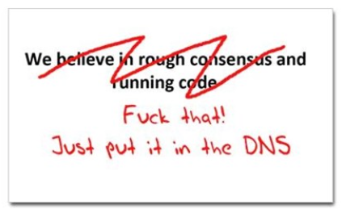
Where now?
Lets use the DNS!
cafepress.com/nxdomain

Slide 21
Seriously
Where better to find out the public key associated with a DNS name than to look it up in the DNS?

Slide 22
Seriously
Where better to find out the public key associated with a DNS name than to look it up in the DNS?
  Why not query the DNS for the HSTS record?
  Why not query the DNS for the issuer CA?
  Why not query the DNS for the hash of the domain name cert?
  Why not query the DNS for the domain name public key cert as a simple self-signed cert?
Who needs CA’s anyway?

Slide 23
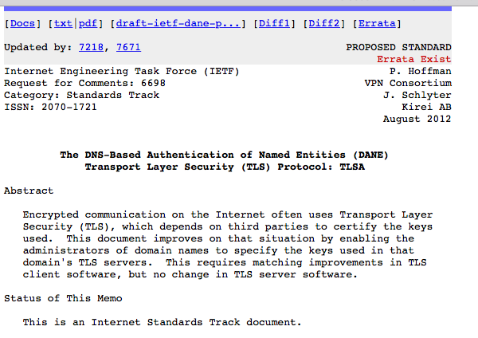
DANE
Using the DNS to associated domain name public key certificates with domain name

Slide 24
TLS with DANE
Client receives server cert in Server Hello
  Client lookups the DNS for the TLSA Resource Record of the domain name
  Client validates the presented certificate against the TLSA RR
Client performs Client Key exchange

Slide 25
The search for small keys
BUT
Large keys and the DNS don’t mix very well:
  Either we try and make UDP fragmentation work reliably (for once!)
  Or we switch the DNS to use TCP
Neither option sounds like fun!
So can we defer the crunch time for a while?

Slide 26
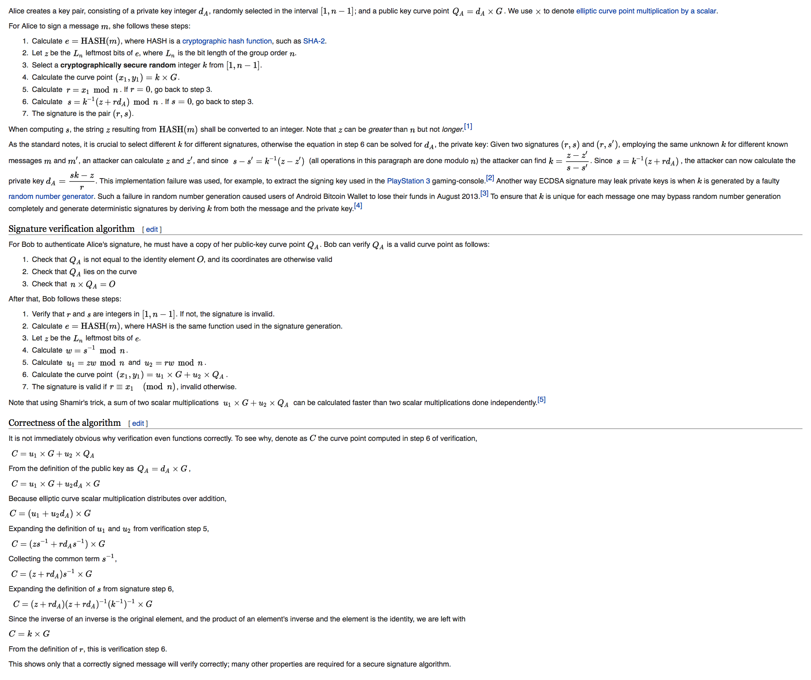
Enter Elliptical Curves

Slide 27
Enter Elliptical Curves
“It is not immediately obvious why verification even functions correctly.”

Slide 28
ECDSA P-256
Elliptic Curve Cryptography allows for the construction of “strong” public/private key pairs with key lengths that are far shorter than equivalent strength keys using RSA
256-bit ECC public key should provide comparable security to a 3072-bit RSA public key

Slide 29
ECDSA vs RSS
$ dig +dnssec u5221730329.s1425859199.i5075.vcf100.5a593.z.dotnxdomain.net
; <<>> DiG 9.9.6-P1 <<>> +dnssec u5221730329.s1425859199.i5075.vcf100.5a593.z.dotnxdomain.net
;; global options: +cmd
;; Got answer:
;; ->>HEADER<<- opcode: QUERY, status: NOERROR, id: 25461
;; flags: qr rd ra ad; QUERY: 1, ANSWER: 2, AUTHORITY: 4, ADDITIONAL: 1
;; OPT PSEUDOSECTION:
; EDNS: version: 0, flags: do; udp: 4096
;; QUESTION SECTION:
;u5221730329.s1425859199.i5075.vcf100.5a593.z.dotnxdomain.net. IN A
;; ANSWER SECTION:
u5221730329.s1425859199.i5075.vcf100.5a593.z.dotnxdomain.net. 1 IN A 199.102.79.186
u5221730329.s1425859199.i5075.vcf100.5a593.z.dotnxdomain.net. 1 IN RRSIG A 5 4 3600 20200724235900 20130729104013 1968 5a593.z.dotnxdomain.net. ghHPoQd71aZtsdH823eWP16g07q80UJAcIcaPrLl9t3lljqecmjbJzfT prxiRetxvfJSoOelTVKNTiT7vUI0Qk8jB40gwYYnZ9GnFKb9RQOVZJWT ddIs8BhePQDbKqSqh5tElH41UhFzSigEK0VIVXzjIruqlGehn3s++ptL TWs=
;; AUTHORITY SECTION:
33d23a33.3b7acf35.9bd5b553.3ad4aa35.09207c36.a095a7ae.1dc33700.103ad556.3a564678.16395067.a12ec545.6183d935.c68cebfb.41a4008e.4f291b87.479c6f9e.5ea48f86.7d1187f1.7572d59a.9d7d4ac3.06b70413.1706f018.0754fa29.9d24b07c.5a593.z.dotnxdomain.net. 1 IN NSEC z1.5a593.z.dotnxdomain.net. A RRSIG NSEC
33d23a33.3b7acf35.9bd5b553.3ad4aa35.09207c36.a095a7ae.1dc33700.103ad556.3a564678.16395067.a12ec545.6183d935.c68cebfb.41a4008e.4f291b87.479c6f9e.5ea48f86.7d1187f1.7572d59a.9d7d4ac3.06b70413.1706f018.0754fa29.9d24b07c.5a593.z.dotnxdomain.net. 1 IN RRSIG NSEC 5 28 1 20200724235900 20130729104013 1968 5a593.z.dotnxdomain.net. OQhZFbIXs5TMETv3zQLk/obD0nQ7IYeaeLTo3XYYh+vKqP1xcvIeNWKk 908SeoMbtdeeY3EZFN7TCLQO6R8qULuvF/u++zbK5pJ1F3nTOdx9gJAH O4iF/YCz/8DUxzMEunGYuUipWctLTaOEqlUKYpbPKDHWhJLhT02ON77g sXI=
5a593.z.dotnxdomain.net. 3599 IN NS nsz1.z.dotnxdomain.net.
5a593.z.dotnxdomain.net. 3600 IN RRSIG NS 5 4 3600 20200724235900 20130729104013 1968 5a593.z.dotnxdomain.net. ntxWo5UwL1vQjOHY0z5DCVNDDScnd3Tglgd0PsBRRhk3B9iJOGH2orxl FRpOeefg7LmpWNtayJOH6nim58ggQU8U/+KZcoNwv0M5TUAo7IRFG+87 ARvw0lcHU9XMGUAr1wDxaicl2fhgg37gDXi5o8Wgdk/2kNsfmrJg8ZMm UPk=
;; Query time: 1052 msec
;; SERVER: 127.0.0.1#53(127.0.0.1)
;; WHEN: Thu Mar 12 03:59:57 UTC 2015
;; MSG SIZE rcvd: 937
$ dig +dnssec u5221730329.s1425859199.i5075.vcf100.5a593.y.dotnxdomain.net
; <<>> DiG 9.9.6-P1 <<>> +dnssec u5221730329.s1425859199.i5075.vcf100.5a593.y.dotnxdomain.net
;; global options: +cmd
;; Got answer:
;; ->>HEADER<<- opcode: QUERY, status: NOERROR, id: 61126
;; flags: qr rd ra ad; QUERY: 1, ANSWER: 2, AUTHORITY: 4, ADDITIONAL: 1
;; OPT PSEUDOSECTION:
; EDNS: version: 0, flags: do; udp: 4096
;; QUESTION SECTION:
;u5221730329.s1425859199.i5075.vcf100.5a593.y.dotnxdomain.net. IN A
;; ANSWER SECTION:
u5221730329.s1425859199.i5075.vcf100.5a593.y.dotnxdomain.net. 1 IN A 144.76.167.10
u5221730329.s1425859199.i5075.vcf100.5a593.y.dotnxdomain.net. 1 IN RRSIG A 13 4 3600 20200724235900 20150301105936 35456 5a593.y.dotnxdomain.net. IMXSIJ/uKixSAt8GXsh6Lm8CvEOmK5n/5bPgsMmqXl7wQTy29P3OiSrB gtNtX5NkxMzt/3ojq3NbUgXa4aAe5A==
;; AUTHORITY SECTION:
ns1.5a593.y.dotnxdomain.net. 1 IN NSEC x.5a593.y.dotnxdomain.net. A RRSIG NSEC
ns1.5a593.y.dotnxdomain.net. 1 IN RRSIG NSEC 13 5 1 20200724235900 20150301105936 35456 5a593.y.dotnxdomain.net. vM+5YEkAc8B9iYHV3ZO3r9v+RvICn3qfWRfneytLP+nHCOku66X31pzB TjHZWCeZzqOKCRHryJe8gqo6G8y/oA==
5a593.y.dotnxdomain.net. 3598 IN NS ns1.5a593.y.dotnxdomain.net.
5a593.y.dotnxdomain.net. 3600 IN RRSIG NS 13 4 3600 20200724235900 20150301105936 35456 5a593.y.dotnxdomain.net. dzFik3O4HhiEg8TXcn3dCFdCfXCzLj7V0y5qIkCNYXYQ5EfoiWMhUh1s Lb9I0CQkOX9Ki/hPtgXRgn2MyTfxbw==
;; Query time: 1880 msec
;; SERVER: 127.0.0.1#53(127.0.0.1)
;; WHEN: Thu Mar 12 03:59:42 UTC 2015
;; MSG SIZE rcvd: 527
ECDSA signed response – 527 octets
RSA signed response – 937 octets

Slide 30
So let’s use ECDSA for DNSSEC
  Yes!

Slide 31
So let’s use ECDSA for DNSSEC
  Yes!
  Let’s do that right now!

Slide 32
So lets use ECDSA for DNSSEC
  Or maybe we should look before we leap...
  Is ECDSA a “well supported” crypto protocol?
  If you signed using ECDSA would resolvers validate the signature?

Slide 33
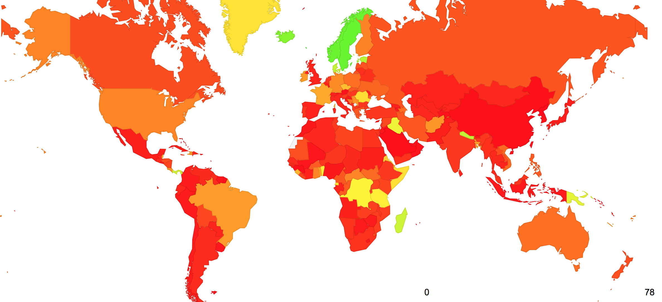
We are now testing for where we see ECDSA Support

Slide 34
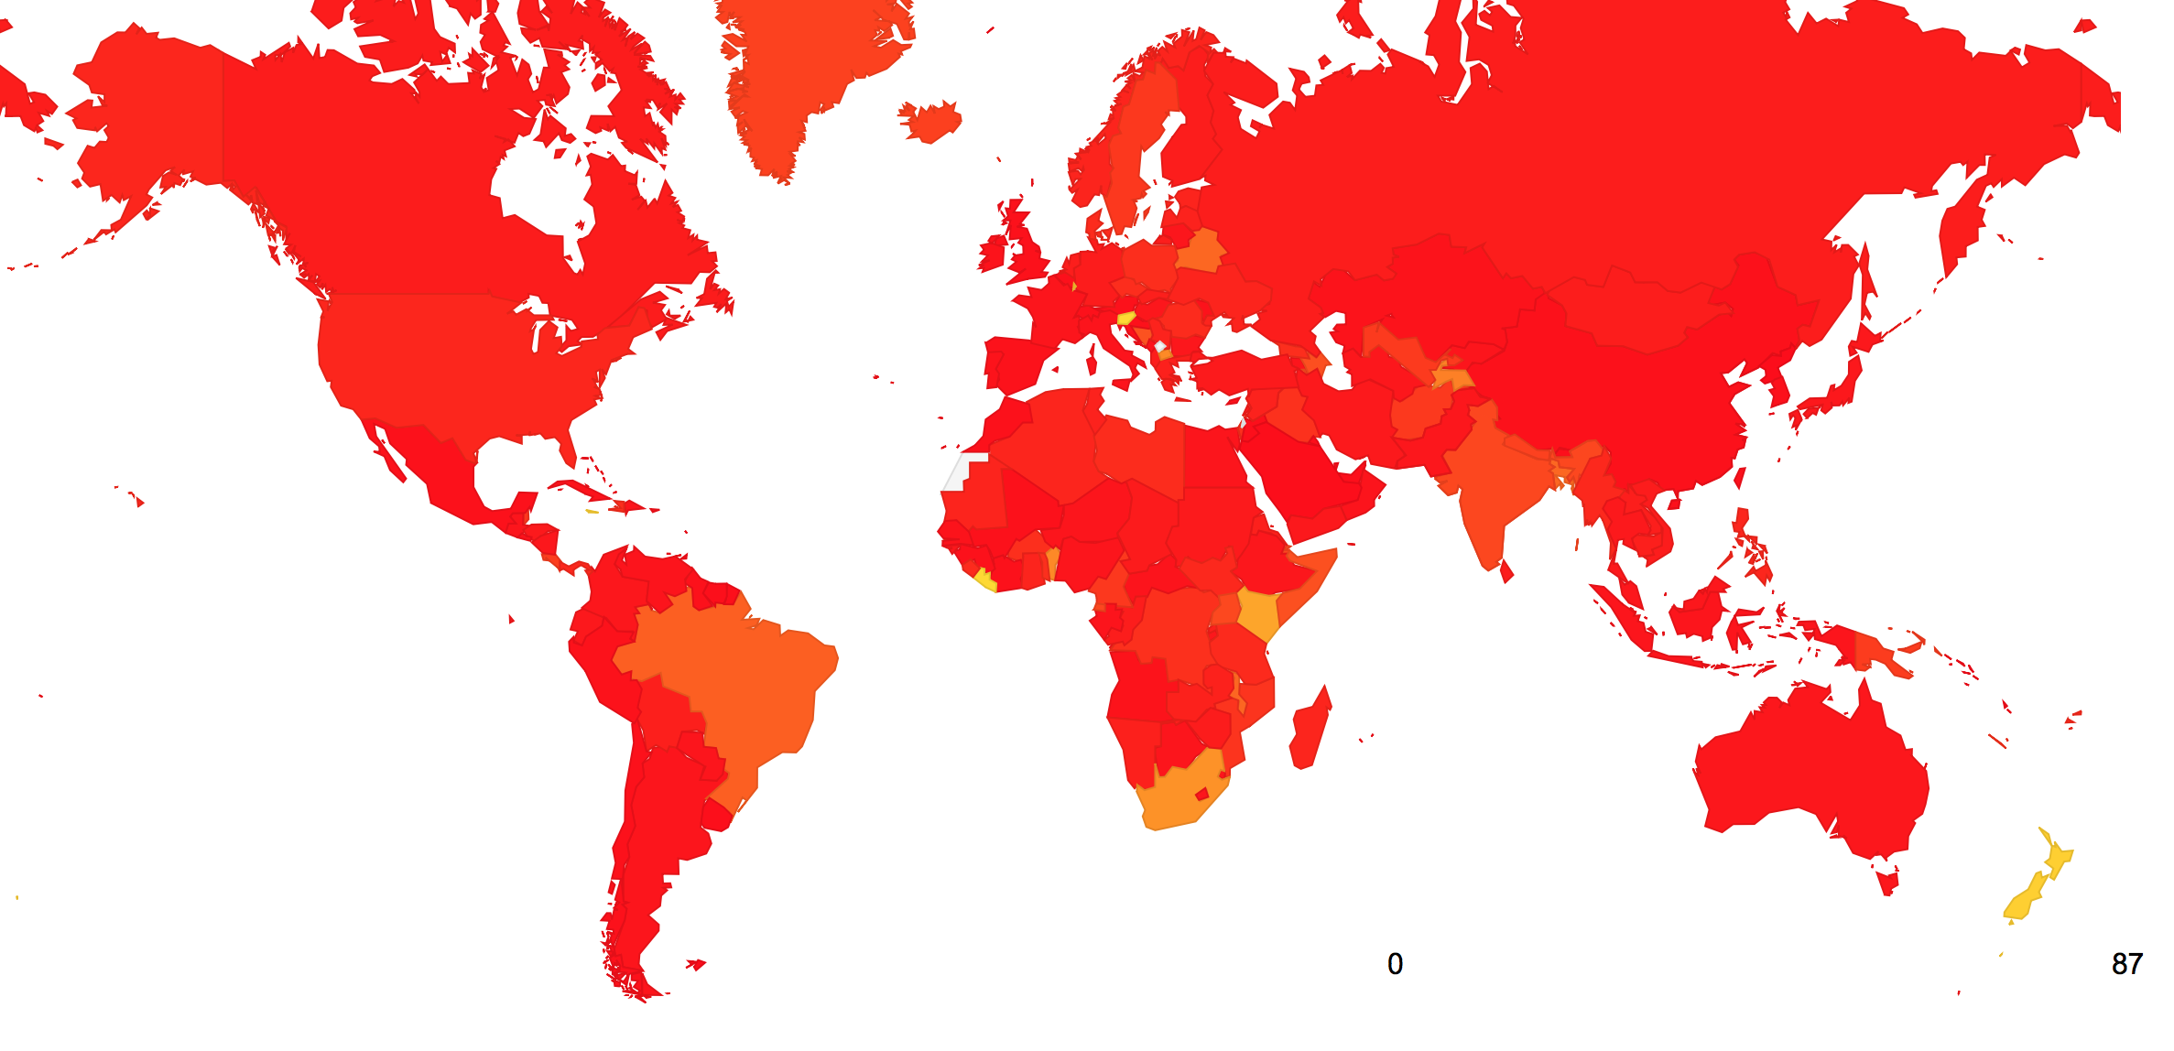
And where we don’t

Slide 35
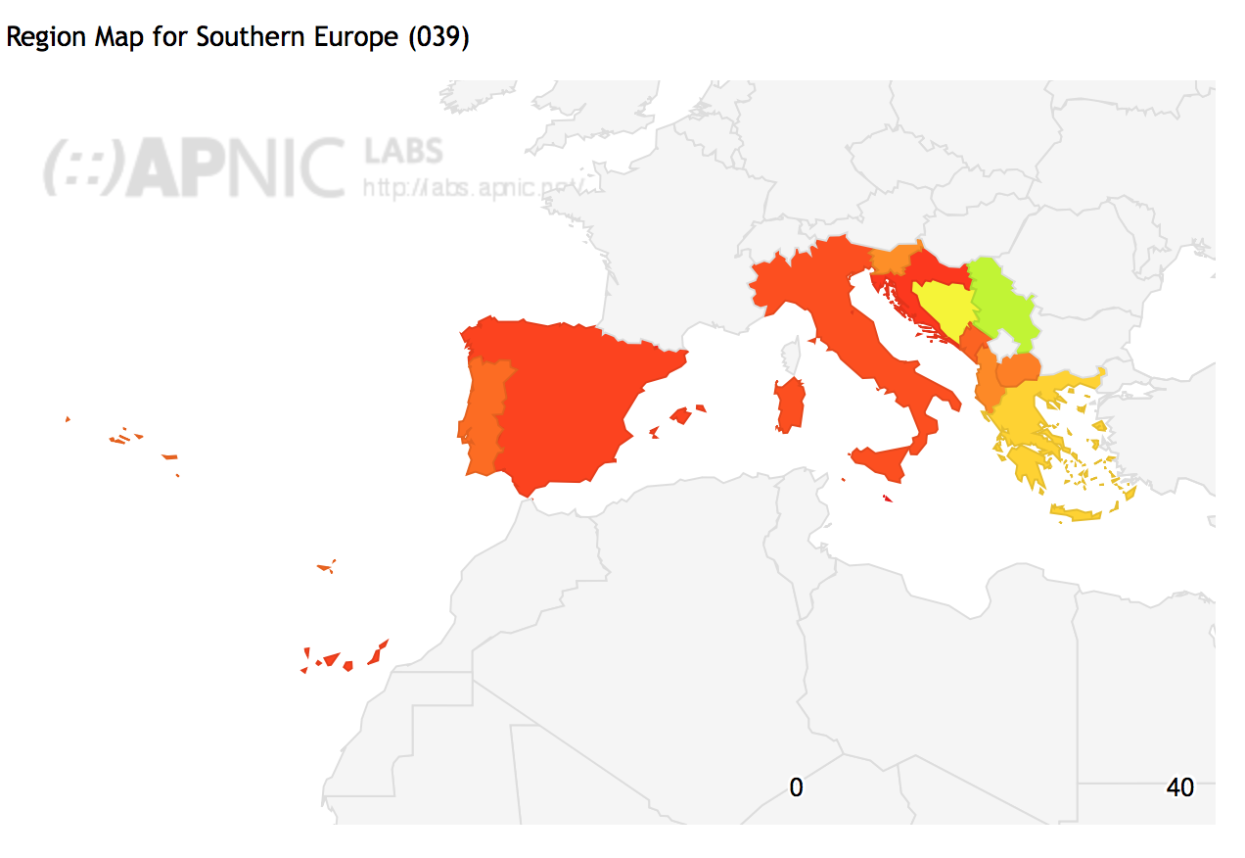
Today we’re in Spain…

Slide 36
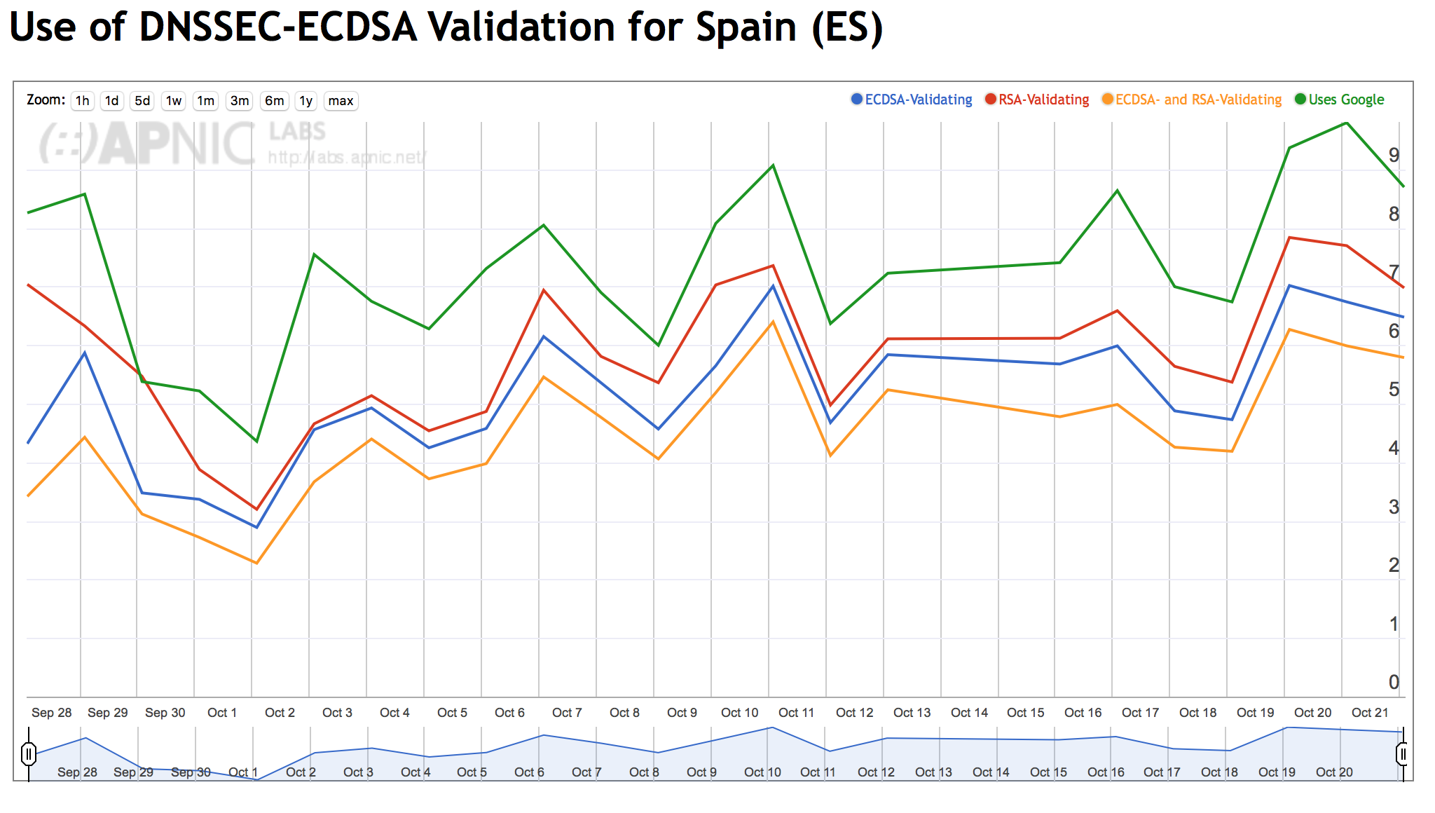
Today we’re in Spain…

Slide 37
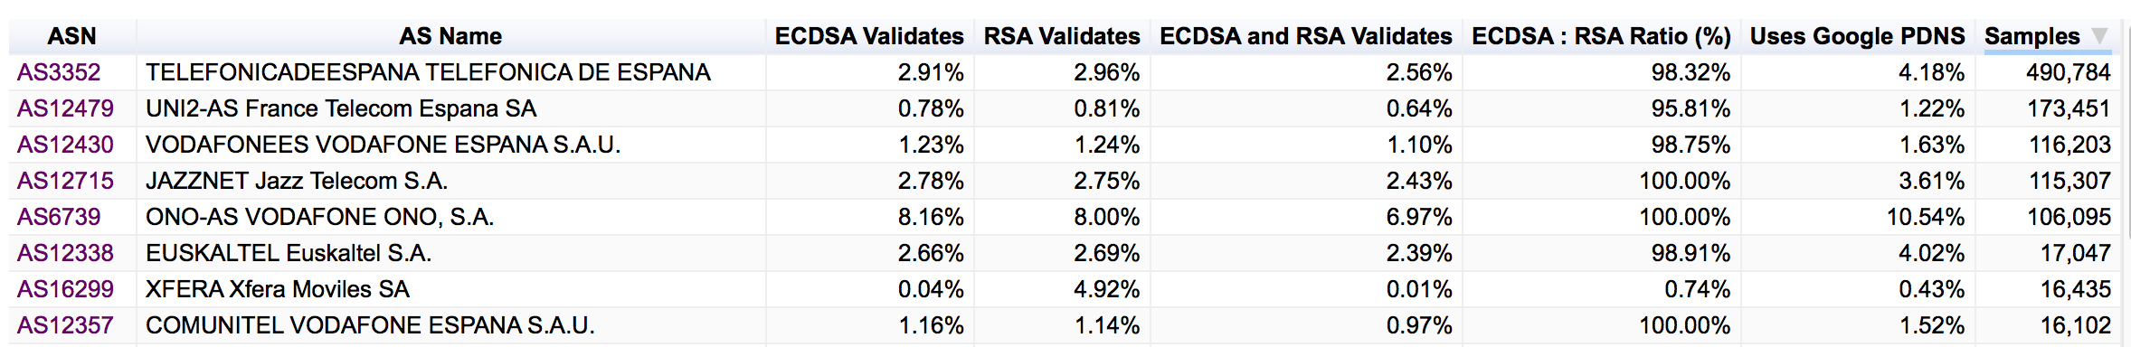
The Top 8 Spanish ISPs
And the extent to which their uses perform DNSSEC validation with ECDSA and RSA

Slide 38
And it if wasn’t for Google…

Slide 39
And it if wasn’t for Google…
There would be no DNSSEC at all!
And no ECDSA!

Slide 40
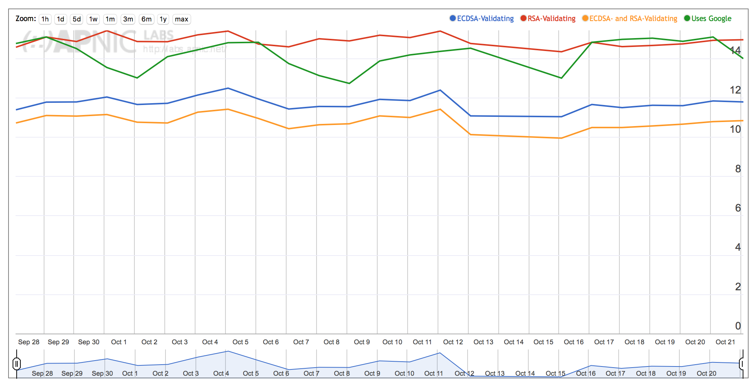
The full daily report
http://stats.labs.apnic.net/ecdsa

